Slide 1
BI MINI PROJECT CENSUS REPORTING SYSTEM
TEAM MEMBERS:
RAGHU SHANKAR KONGRA
SHREYA PANDEY
PRABU THIRUNAVUKKARASU
SOMYA SHIVHARE
BALASUNDARAM PRABHAKAR
NEETHU PATTLIKADAN
Mentor Name:
Jayavibhava

Slide 2
INTRODUCTION: CENSUS
A Census is the procedure of systematically acquiring and recording information about the members of a given population.
The Population Census is the most detailed information source on the population at the level of small localities and small groups in population.
The data acquired forms the basis of information that is available to public and private elements at the national and local level for the purpose of decision making in variety of areas of the life of residents of the cities.

Slide 3
SCOPE OF THE PROJECT
The purpose of this project is to gather information about general population in order to present a full and reliable picture of population in Cities- its Demographic and housing conditions, social and economic characteristics.
This project is essential for City wise comparisons of any kind of Statistics.
It collects data on many attributes of population, along with the count of the people
It gives City wise, Gender wise population, Birth rate, Death rate, Occupation, Religion and Education details of the people.

Slide 4
ARCHITECTURE
Heterogeneous Sources (Flat File)
Extract
Transform
Load
(Informatica)
Data Warehouse (Oracle)

Slide 5
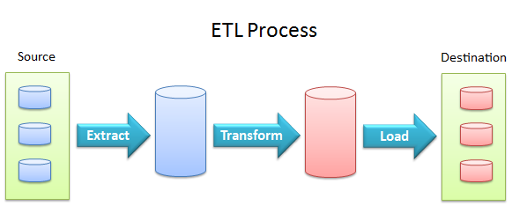
ETL PROCESS
Data comes from various sources, such as spreadsheets, mail lists, databases, etc.
The required data is extracted, transformed to suit information needs and finally loaded at a central location.
This is done by ETL (Extract Transform Load) process.

Slide 6
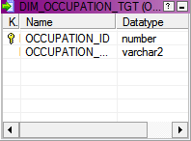
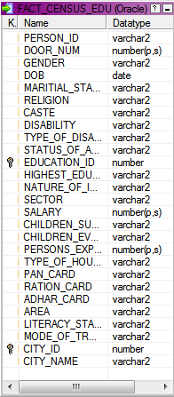
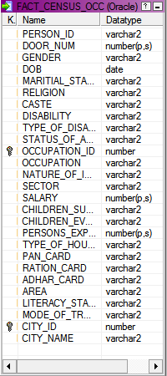
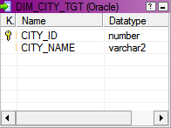
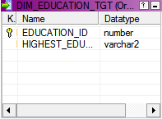
SCHEMA
OCCUPATION DIMENSION
EDUCATION FACT
OCCUPATION FACT
CITY DIMENSION
EDUCATION FACT

Slide 7
TECHNOLOGY
HARDWARE:
Intel Core™ i5 CPU
Microsoft Windows 7 Enterprise
Memory and OS: 8GB RAM and 64 Bit Operating System
SOFTWARE:
Oracle 11g (Database)
Informatica PowerCenter 9.6.0 (ETL Tool):-
BusinessObjects XI Release 4

Slide 8
FLOW OF THE PROJECT:
FLAT FILE
STAGING TABLE
DIMENSION TABLES
FACT TABLES

Slide 9
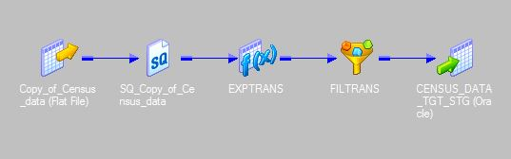
MAPPING
STAGING TABLE MAPPING:
Expressions
Filter Conditions

Slide 10
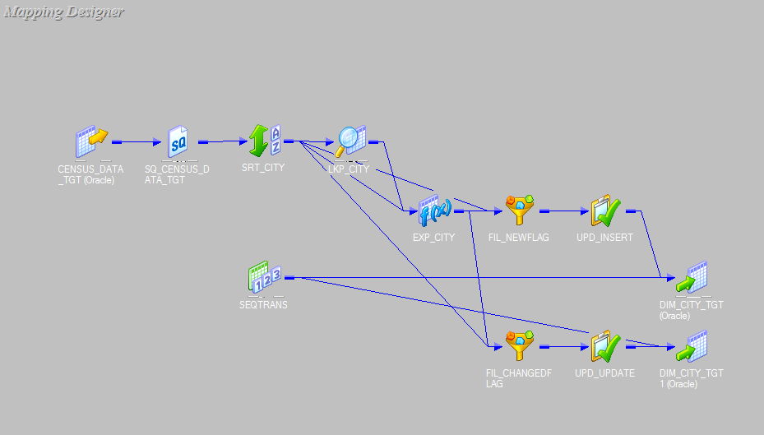
MAPPING OF DIMENSIONAL TABLE
MAPPING FOR CITY: SCD TYPE-1
Lookup Condition
Expressions – New Flag
Expressions – Changed Flag

Slide 11
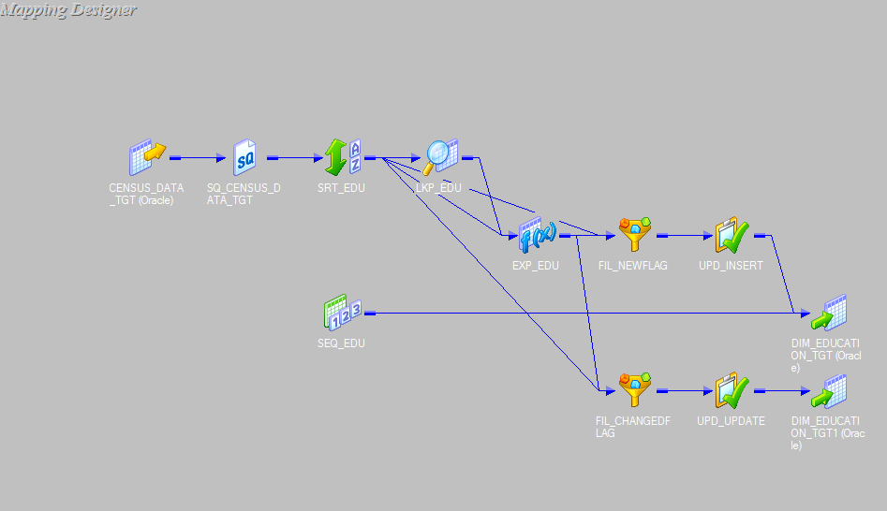
MAPPING OF DIMENSIONAL TABLE
MAPPING FOR EDUCATION: SCD TYPE-1

Slide 12
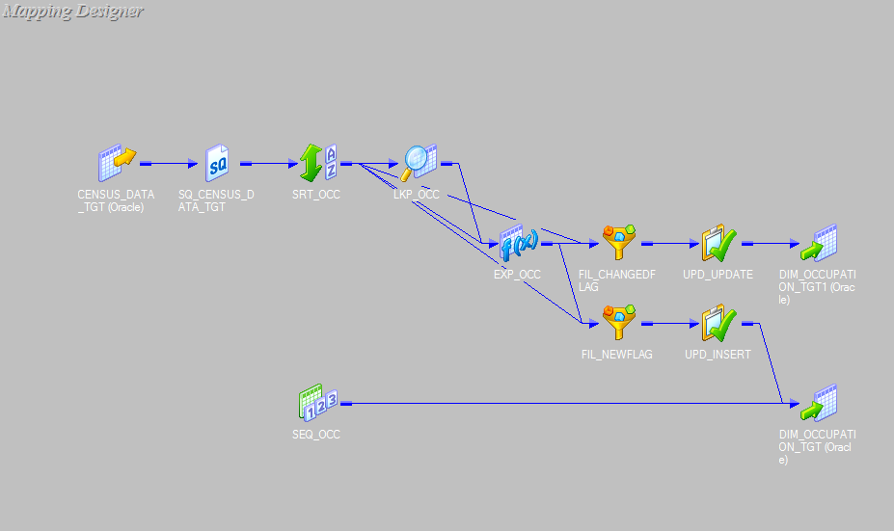
MAPPING OF DIMENSIONAL TABLE
MAPPING FOR OCCUPATION: SCD TYPE-1

Slide 13
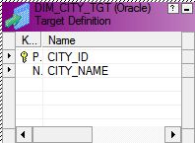
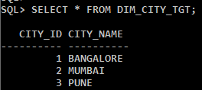
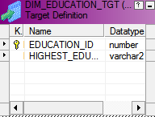
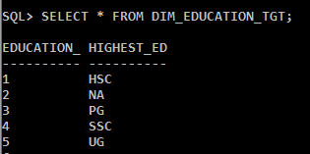
OUTPUT FOR DIMENSIONAL TABLES
DIMENSION TABLE : CITY
DIMENSION TABLE : EDUCATION

Slide 14
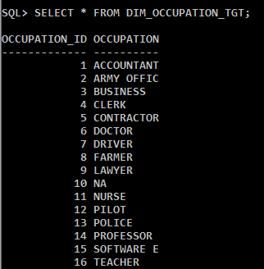
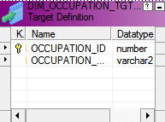
OUTPUT FOR DIMENSIONAL TABLES
DIMENSION TABLE : OCCUPATION

Slide 15
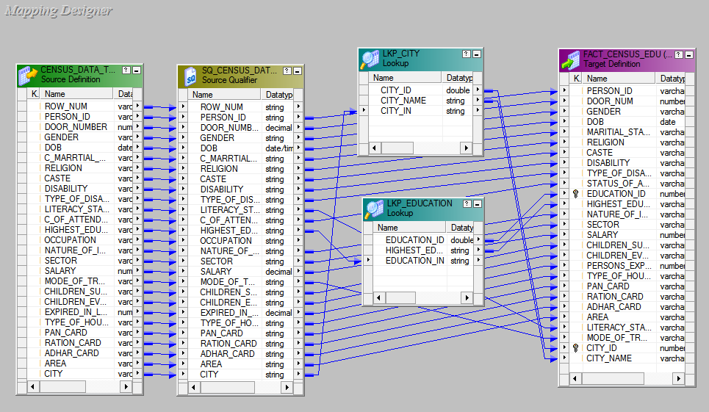
MAPPING FOR FACT TABLE : EDUCATION
Lookup Transformations

Slide 16
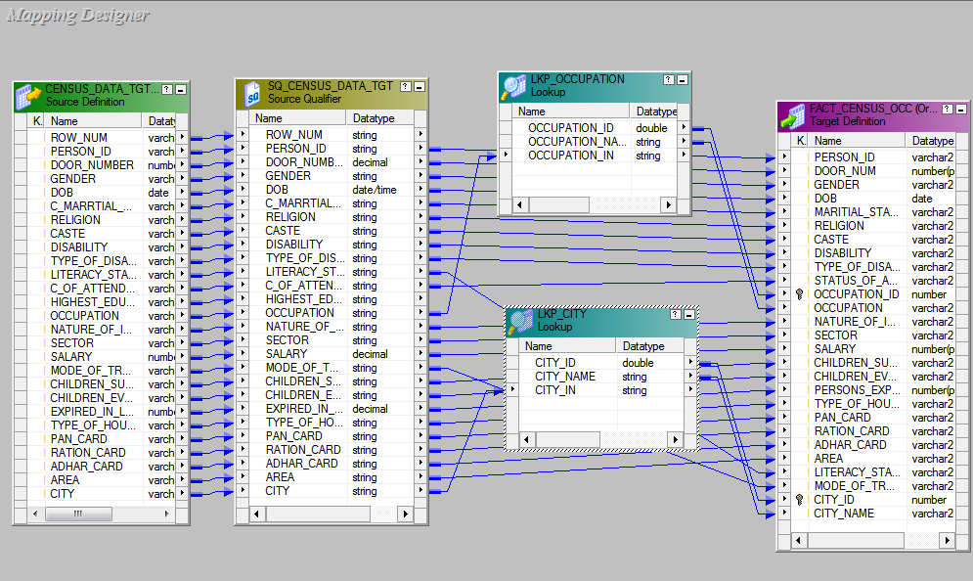
MAPPING FOR FACT TABLE : OCCUPATION
Lookup Transformations

Slide 17


Slide 18
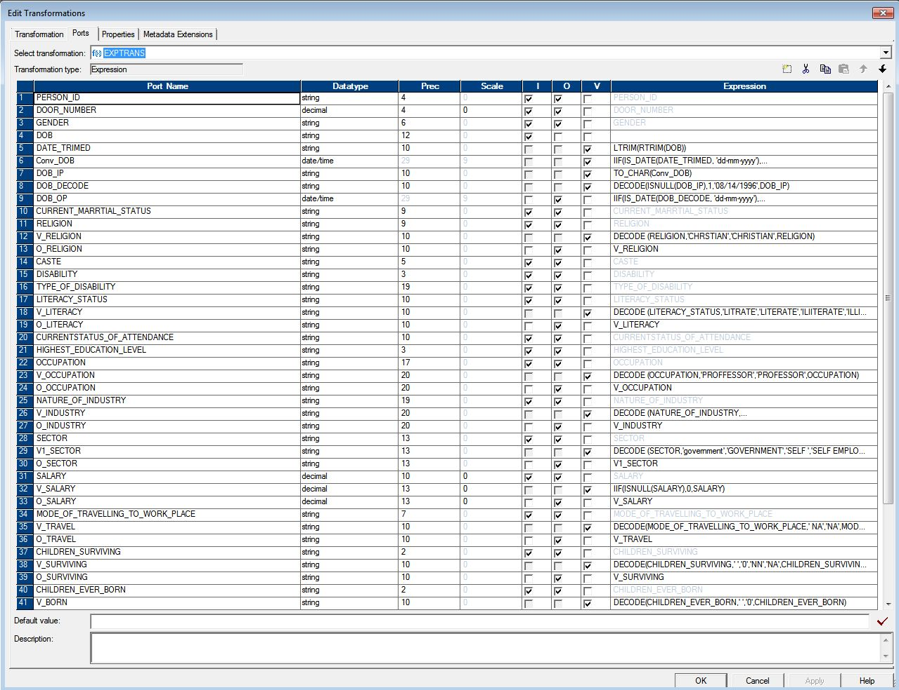
Expression Transformation for Stage table
Mapping Slide

Slide 19
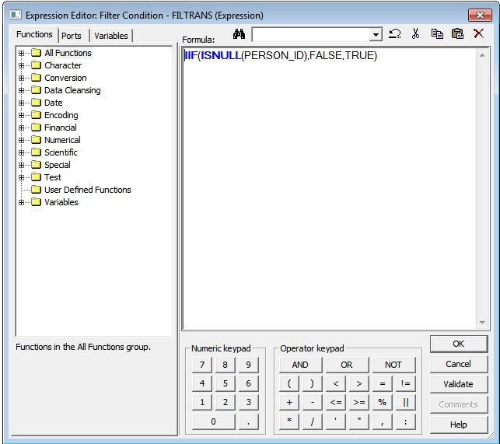
Filter Transformation for Stage Table
Mapping Slide

Slide 20
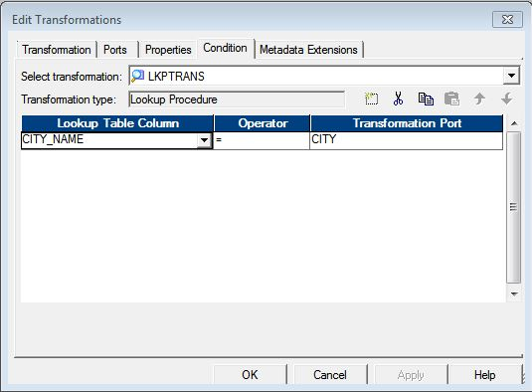
Lookup Condition for Dimensional Table
Mapping Slide

Slide 21
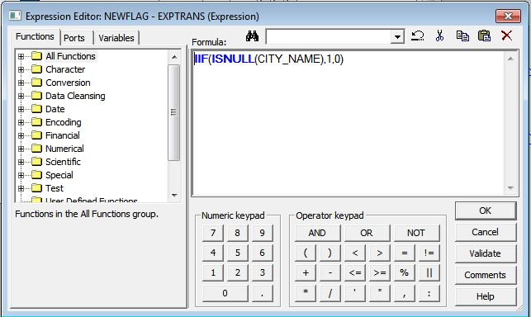
Expression for New Flag for inserting data to Dimensional table
Mapping Slide

Slide 22
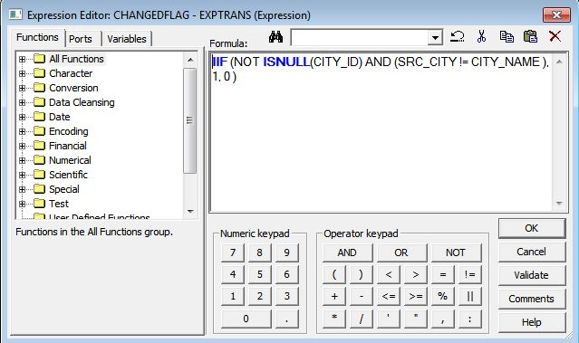
Expression for Changed Flag for inserting data to Dimensional table
Mapping Slide

Slide 23
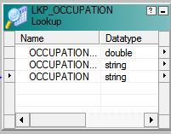
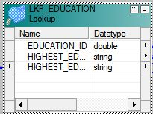
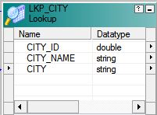
Lookup Transformations for Fact Tables
Mapping Slide

